Slide 1
An Intro to Video4Linux2
Presented by
Kowshic Shankar R

Slide 2
What is Video4Linux
Video4Linux (V4L for short) is a collection of device drivers and an API for supporting realtime video capture on Linux systems.
It supports USB webcams, TV tuners, CSI cameras, and related devices, standardizing their output, so programmers can easily add video support to their applications.

Slide 3
What is ioctl()
The ioctl() system call manipulates the underlying device parameters of special files.
The first argument fd must be an open file descriptor.
The second argument is a device-dependent operation code.
The third argument is an untyped pointer to memory.

Slide 4
ioctl()
Syntax:
#include <sys/ioctl.h>
int ioctl(int fd, unsigned long op, ...);
Return Value:
Usually, on success zero is returned. A few ioctl() operations use the return value as an output parameter and return a nonnegative value on success.
ERRORS
EBADF fd is not a valid file descriptor.
EFAULT argp references an inaccessible memory area.
EINVAL op or argp is not valid.
ENOTTY fd is not associated with a character special device.
ENOTTY The specified operation does not apply to the kind of object that the file descriptor fd references.

Slide 5
Opening a Video Device
Unlike opening a normal file in c using fopen(), here we use a open() function from fcntl.h library.
Return non negative number denoting the index of file descriptor on the table.
#include <fcntl.h>
fd = open("/dev/video0", O_RDWR);
if (fd == -1) {
perror("open");
return EXIT_FAILURE;
  }

Slide 6
Querying Device Capabilities
We use the ioctl command , with op code VIDIOC_QUERYCAP and a pointer to a structure v4l2_capability defined in linux/videodev2.h
#include <sys/ioctl.h>
#include <linux/videodev2.h>
struct v4l2_capability cap;
memset(&cap, 0, sizeof(cap));
if (ioctl(fd, VIDIOC_QUERYCAP, &cap) == -1) {
perror("VIDIOC_QUERYCAP");
close(fd);
return EXIT_FAILURE;
}
printf("Driver : %s\n", cap.driver);
printf("Card : %s\n", cap.card);

Slide 7
ioctl VIDIOC_QUERYCAP
All V4L2 devices support the VIDIOC_QUERYCAP ioctl.
It is used to identify kernel devices compatible with this specification and to obtain information about driver and hardware capabilities.
The ioctl takes a pointer to a struct v4l2_capability which is filled by the driver.
When the driver is not compatible with this specification the ioctl returns an EINVAL error code.

Slide 8
struct v4l2_capability
Field | Type | Description
driver | __u8[16] | Name of the driver.
card | __u8[32] | Name of the device.
bus_info | __u8[32] | Location of the device in the system.
version | __u32 | Version number of the driver.
capabilities | __u32 | Available capabilities of the physical device.
device_caps | __u32 | Capabilities of the opened device node.
reserved[3] | __u32[3] | Reserved for future extensions.

Slide 9
Device Capability Flags
Flag | Description
V4L2_CAP_VIDEO_CAPTURE | Supports the single-planar Video Capture API.
V4L2_CAP_VIDEO_CAPTURE_MPLANE | Supports the multi-planar Video Capture API.
V4L2_CAP_STREAMING | Supports the streaming I/O method.
V4L2_CAP_DEVICE_CAPS | Driver fills the device_caps field.

Slide 10
Setting Video Format
We use the ioctl command , with op code VIDIOC_S_FMT and a pointer to a structure v4l2_format defined in linux/videodev2.h.
The v4l2_format structure should be passed with necessary elements initialized like type, width, height, pixelformat and field.
We can use VIDIOC_G_FMT similarly to get the current v4l2_format.
#include <sys/ioctl.h>
#include <linux/videodev2.h>
struct v4l2_format fmt;
memset(&fmt, 0, sizeof(fmt));
fmt.type = V4L2_BUF_TYPE_VIDEO_CAPTURE;
fmt.fmt.pix.width = WIDTH;
fmt.fmt.pix.height = HEIGHT;
fmt.fmt.pix.pixelformat = V4L2_PIX_FMT_YUYV;
fmt.fmt.pix.field = V4L2_FIELD_ANY;
if (ioctl(fd, VIDIOC_S_FMT, &fmt) == -1) {
perror("VIDIOC_S_FMT");
close(fd);
return EXIT_FAILURE;
}

Slide 11
ioctl VIDIOC_S_FMT
When the application calls the VIDIOC_S_FMT ioctl with a pointer to a struct v4l2_format structure the driver checks and adjusts the parameters against hardware abilities.
Drivers should not return an error code unless the type field is invalid.
On success the driver may program the hardware, allocate resources and generally prepare for data exchange.
Finally the VIDIOC_S_FMT ioctl returns the current format parameters as VIDIOC_G_FMT does.
Very simple, inflexible devices may even ignore all input and always return the default parameters.

Slide 12
struct v4l2_format
Field | Type | Description
type | __u32 | Type of the data stream.
fmt.pix | v4l2_pix_format | Single-planar video capture or output format.
fmt.pix_mp | v4l2_pix_format_mplane | Multi-planar video capture or output format.
fmt.win | v4l2_window | Parameters for an overlaid image.
fmt.vbi | v4l2_vbi_format | Raw VBI capture or output parameters.
fmt.sliced | v4l2_sliced_vbi_format | Sliced VBI capture or output parameters.
fmt.sdr | v4l2_sdr_format | SDR capture or output format parameters.

Slide 13
struct v4l2_pix_format
Field | Type | Description
width | __u32 | Image width in pixels.
height | __u32 | Image width in pixels.
pixelformat | __u32 | Pixel format or type of compression.
field | enum v4l2_field | Video field order.
bytesperline | __u32 | Distance in bytes between adjacent image lines.
sizeimage | __u32 | Size in bytes required for a complete image.
colorspace | enum v4l2_colorspace | Color space of the image.
priv | __u32 | Indicates whether extended fields are valid.
flags | __u32 | Format-specific flags.
With ioctl VIDIOC_ENUM_FMT we can query the available pixel formats.

Slide 14
Requesting MMAP Buffers
#include <sys/ioctl.h>
#include <linux/videodev2.h>
#define NUM_BUFFERS 4
struct v4l2_requestbuffers req;
memset(&req, 0, sizeof(req));
req.count = NUM_BUFFERS;
req.type = V4L2_BUF_TYPE_VIDEO_CAPTURE;
req.memory = V4L2_MEMORY_MMAP;
if (ioctl(fd, VIDIOC_REQBUFS, &req) == -1) {
perror("VIDIOC_REQBUFS");
close(fd);
return EXIT_FAILURE;
}
printf("Number of buffers: %u\n", req.count);
Buffers are memory locations that store the data from the device.
We need to request Buffers for MMAP.
We use ioctl VIDIOC_REQBUFS with argument v4l2_requestbuffers that contain count of buffer needed and type.

Slide 15
ioctl VIDIOC_REQBUFS
This ioctl is used to initiate memory mapped, user pointer or DMABUF based I/O.
Memory mapped buffers are located in device memory and must be allocated with this ioctl before they can be mapped into the application’s address space.
To allocate device buffers applications initialize all fields of the struct v4l2_requestbuffers structure.
They set the type field to the respective stream or buffer type, the count field to the desired number of buffers, memory must be set to the requested I/O method and the reserved array must be zeroed.

Slide 16
struct v4l2_requestbuffers
Field | Type | Description
count | __u32 | The number of buffers requested or granted.
type | __u32 | Type of the stream or buffers.
memory | __u32 | Requested I/O method: MMAP, DMABUF or USERPTR.
reserved[2] | __u32 | Reserved for future extensions and must be zeroed.

Slide 17
mmap()
mmap() creates a new mapping in the virtual address space of the
calling process.
The starting address for the new mapping is specified in addr.
The length argument specifies the length of the mapping (which must be greater than 0).
If addr is NULL, then the kernel chooses the (page-aligned) address at which to create the mapping, this is the most portable method of creating a new mapping.
On success, mmap() returns a pointer to the mapped area.

Slide 18
munmap()
The munmap() system call deletes the mappings for the specified address range, and causes further references to addresses within the range to generate invalid memory references.
The region is also automatically unmapped when the process is terminated.
On success, munmap() returns 0.

Slide 19
mmap() & munmap()
Syntax:
#include <sys/mman.h>
void *mmap(
void addr[length], size_t length;
  int prot, int flags, int fd, off_t offset);
int munmap(
  void addr[length], size_t length);
The prot argument describes the desired memory protection of the mapping
We need PROT_READ and PROT_WRITE for a v4l2 buffer.
The flags argument determines whether updates to the mapping are visible to other processes mapping the same region, and whether updates are carried through to the underlying file.
In v4l2 we use MAP_SHARED by default.

Slide 20
Querying Each Buffer and MMAP
#include <sys/ioctl.h>
#include <sys/mman.h>
#include <linux/videodev2.h>
#define NUM_BUFFERS 4
struct buffer {
void *start;
size_t length;
};
static struct buffer buffers[NUM_BUFFERS];
for (i = 0; i < req.count; i++) {
struct v4l2_buffer buf;
memset(&buf, 0, sizeof(buf));
buf.type = V4L2_BUF_TYPE_VIDEO_CAPTURE;
buf.memory = V4L2_MEMORY_MMAP;
buf.index = i;
if (ioctl(fd, VIDIOC_QUERYBUF, &buf) == -1) {
perror("VIDIOC_QUERYBUF");
close(fd);
return EXIT_FAILURE;
}
buffers[i].length = buf.length;
buffers[i].start = mmap(
NULL, buf.length,
PROT_READ | PROT_WRITE,
MAP_SHARED,
fd, buf.m.offset
);
}
To initialize each buffer memory we will be using ioctl VIDIOC_QUERYBUF and passing the v4l2_buffer structure with its buffer index and type.
It will give the requested buffer in the structure and we need to mmap it.

Slide 21
ioctl VIDIOC_QUERYBUF
This ioctl can be used to query the status of a buffer at any time after buffers have been allocated with the ioctl VIDIOC_REQBUFS ioctl.
Applications set the type field of a struct v4l2_buffer to the same buffer type as was previously used with struct v4l2_format type and struct v4l2_requestbuffers type, and the index field.
Valid index numbers range from zero to the number of buffers allocated with ioctl VIDIOC_REQBUFS (struct v4l2_requestbuffers count) minus one.

Slide 22
struct v4l2_buffer
Field | Type | Description
index | __u32 | Identifies the buffer by its index number.
type | __u32 | Type of the buffer or stream.
bytesused | __u32 | Number of bytes occupied by valid data.
flags | __u32 | Buffer status and state flags.
field | __u32 | Field order of the video frame.
timestamp | struct timeval | Timestamp associated with the buffer.
m.offset | __u32 | Offset of the buffer from the start of device memory.
length | __u32 | Offset of the buffer from the start of device memory.
For the single-planar API, the m.offset contains the offset of the buffer from the start of the device memory, the length field its size.
The above is a slice of the structure , for full structure refer official documentation.

Slide 23
Queue of Buffers
ioctl VIDIOC_QBUF
Applications call the VIDIOC_QBUF ioctl to enqueue an empty buffer in the driver’s incoming queue.
ioctl VIDIOC_DQBUF
Applications call the VIDIOC_DQBUF ioctl to dequeue a filled buffer from the driver’s outgoing queue.
They just set the type, memory and reserved fields of a struct v4l2_buffer, when VIDIOC_QBUF or VIDIOC_DQBUF is called with a pointer to this structure the driver fills the remaining fields or returns an error code.

Slide 24
Streaming
ioctl VIDIOC_STREAMON
The VIDIOC_STREAMON and VIDIOC_STREAMOFF ioctl start and stop the capture or output process.
Capture hardware is disabled and no input buffers are filled (if there are any empty buffers in the incoming queue) until VIDIOC_STREAMON has been called.
The ioctl will succeed when at least one output buffer is in the incoming queue.
If VIDIOC_STREAMON fails then any already queued buffers will remain queued.
ioctl VIDIOC_STREAMOFF
The VIDIOC_STREAMOFF ioctl removes all buffers from the incoming and outgoing queues. That means all images captured but not dequeued yet will be lost.
I/O returns to the same state as after calling ioctl VIDIOC_REQBUFS and can be restarted accordingly.

Slide 25

Analogy

Slide 26

Analogy

Slide 27

Analogy

Slide 28

Analogy

Slide 29

Analogy

Slide 30

Analogy

Slide 31
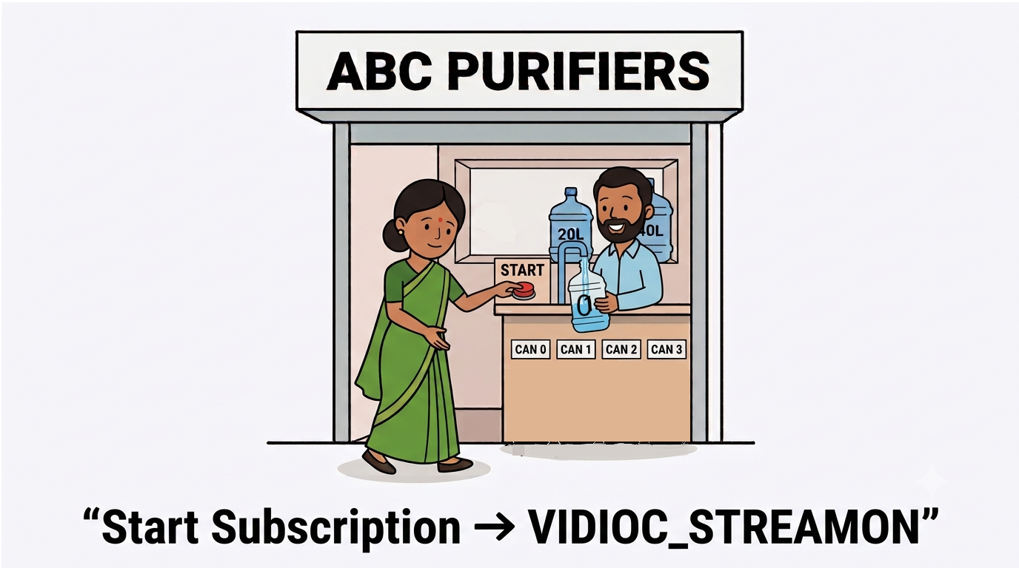
Analogy

Slide 32

Analogy

Slide 33

Analogy
QBUF -> DBUF -> QBUF ..... Loop

Slide 34
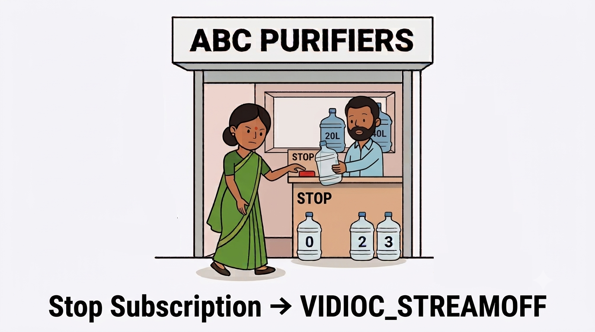
Analogy

Slide 35
Multi-Planar Format
A video frame can be divided into multiple memory planes, where each plane stores a different part of the image data.
Instead of treating the frame as one block of memory, V4L2 can describe it as multiple planes.
YUVU
Y
UV
Single Planar
Memory Layout
Multi Planar (Eg : NV12)
Memory Layout

Slide 36
Single Vs Multi Planar
Single Planar | Multi Planar
One plane | Multiple planes
V4L2_BUF_TYPE_VIDEO_CAPTURE | V4L2_BUF_TYPE_VIDEO_CAPTURE_MPLANE
fmt.pix | fmt.pix_mp
Buf.m.offset | Buf.m.planes[p].m.mem_offset
MMAP
buffers[i].planes[p].length =
buf.m.planes[p].length;
buffers[i].planes[p].start =
mmap(NULL, buf.m.planes[p].length,
PROT_READ | PROT_WRITE,
MAP_SHARED,
fd, buf.m.planes[p].m.mem_offset);
Creating Buffer
struct v4l2_plane planes[VIDEO_MAX_PLANES];
struct v4l2_buffer buf = {
.type = V4L2_BUF_TYPE_VIDEO_CAPTURE_MPLANE,
.m.planes = planes,
.length = 2,
};

Slide 37
MMAP vs USERPTR Methods
MMAP
Driver allocates the video buffers.
Application calls VIDIOC_REQBUFS.
Application calls VIDIOC_QUERYBUF to get buffer offset and size.
Application calls mmap() to access the driver-allocated memory.
Buffer is then passed using VIDIOC_QBUF.
USERPTR
Application allocates the memory.
Application calls VIDIOC_REQBUFS to initialize the buffer queue.
VIDIOC_QUERYBUF is not needed to obtain the user memory.
Application passes the memory address using VIDIOC_QBUF.
Driver uses/prepares that user-provided memory for the capture operation.

Slide 38
V4L2 Controls
Controls are used to configure and query device parameters such as: Brightness, Contrast, Saturation, Exposure, Gain, White balance
Each control is identified by a Control ID.
ioctl VIDIOC_QUERYMENU is used to list the supported controls
ioctl VIDIOC_QUERYCTRL is used to get maximum, minumum and default value of a control.
ioctl VIDIOC_S_CTRL is used to set a control value.
ioctl VIDIOC_G_CTRL is used to get a control current value.

Slide 39
V4L2 Controls
int fd = open("/dev/video0", O_RDWR);
struct v4l2_queryctrl q = {
.id = V4L2_CID_BRIGHTNESS
};
ioctl(fd, VIDIOC_QUERYCTRL, &q);
struct v4l2_control c = {
.id = V4L2_CID_BRIGHTNESS
};
ioctl(fd, VIDIOC_G_CTRL, &c);
printf("Brightness: current=%d min=%d max=%d default=%d\n",
c.value, q.minimum, q.maximum, q.default_value);
printf("Enter new value: ");
scanf("%d", &c.value);
ioctl(fd, VIDIOC_S_CTRL, &c);
close(fd);

Slide 40
References
https://www.kernel.org/doc/html/v4.12/media/uapi/v4l/v4l2.html
https://en.wikipedia.org/wiki/Video4Linux
https://man7.org/linux/man-pages/index.html

